Slide 1
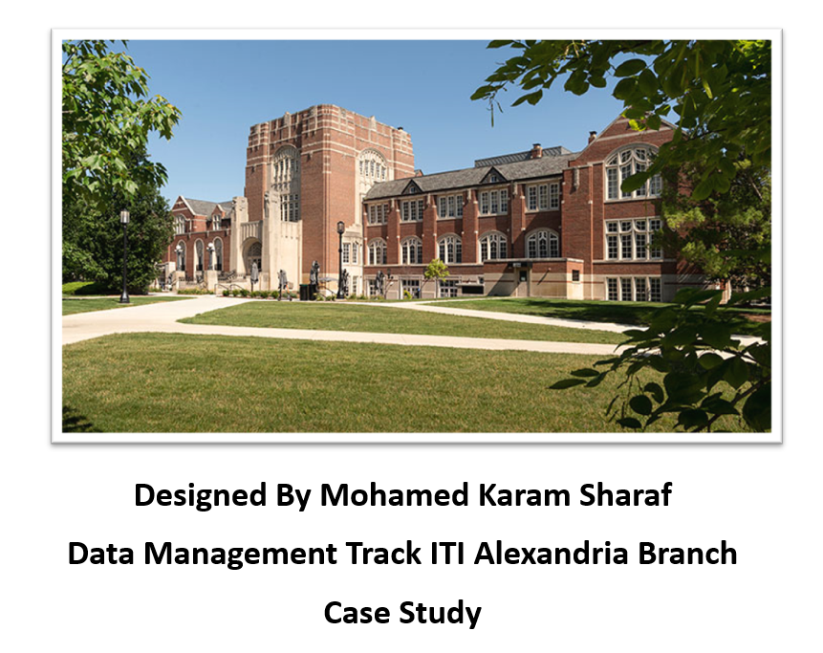

Slide 2
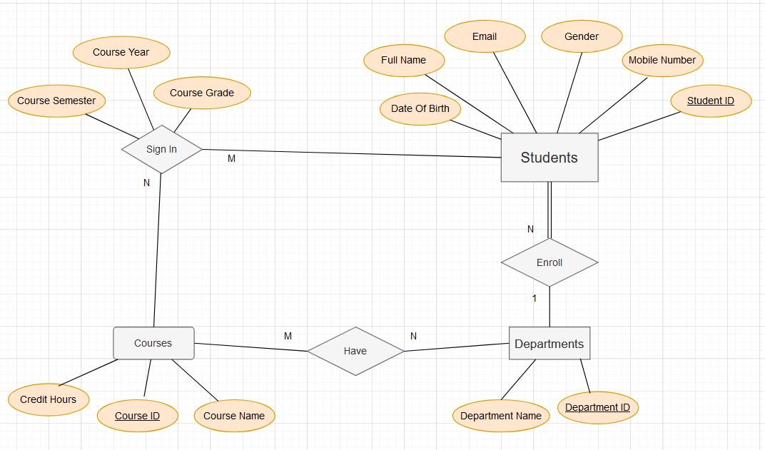
Schema Implementation

Slide 3
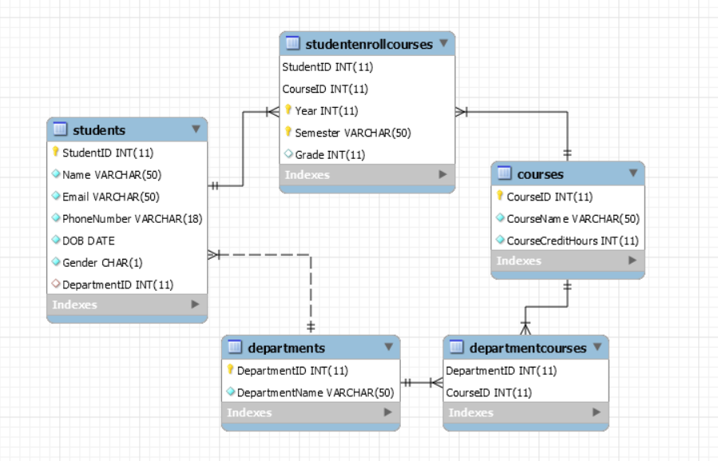
Table Relations

Slide 4
PL SQL Codes
-- Function to Get Student's Full Name:
--Procedure to Enroll a Student in a Course:
-- Trigger to Update Course Credit Hours when a New Course is Inserted:
-- Function to Calculate GPA for a Student:
-- Function to getEnrolledCourseCount :
-- Function to calculateCourseGrade :

Slide 5
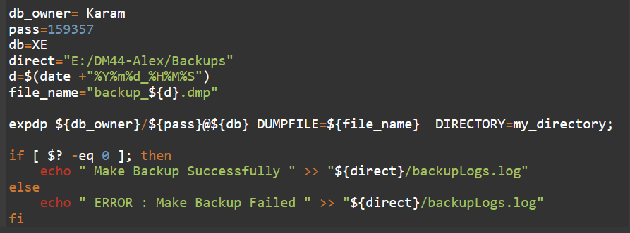
Data Base Back Up

Slide 6
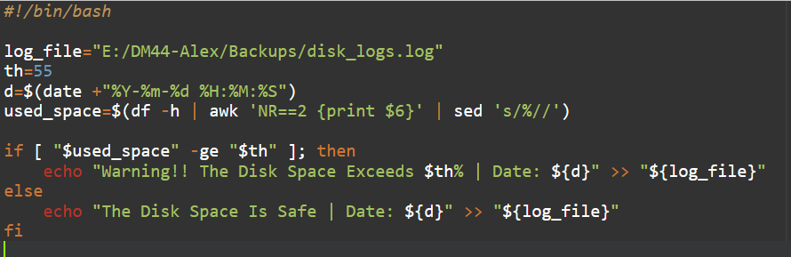
Disk Space Monitoring

Slide 7
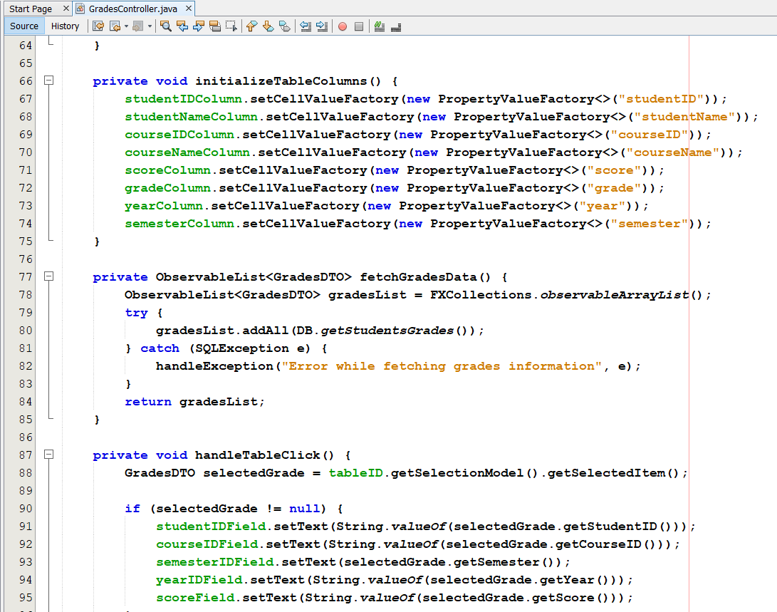
Example of Grades Controller

Slide 8
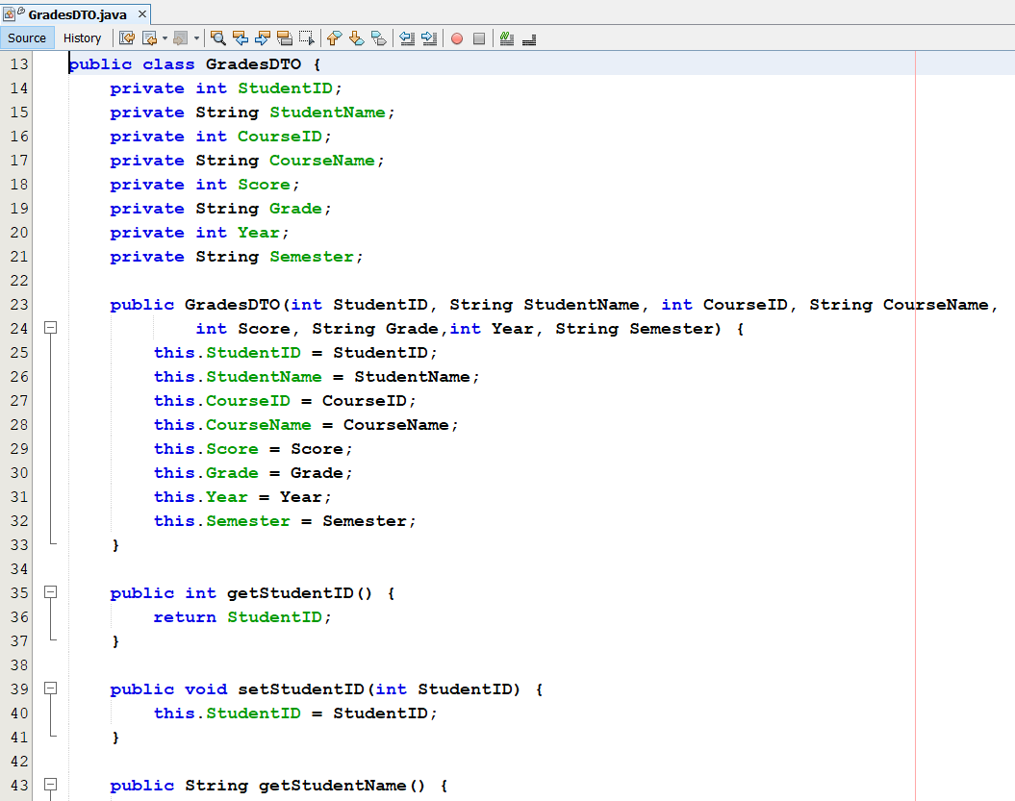
DTO Example

Slide 9
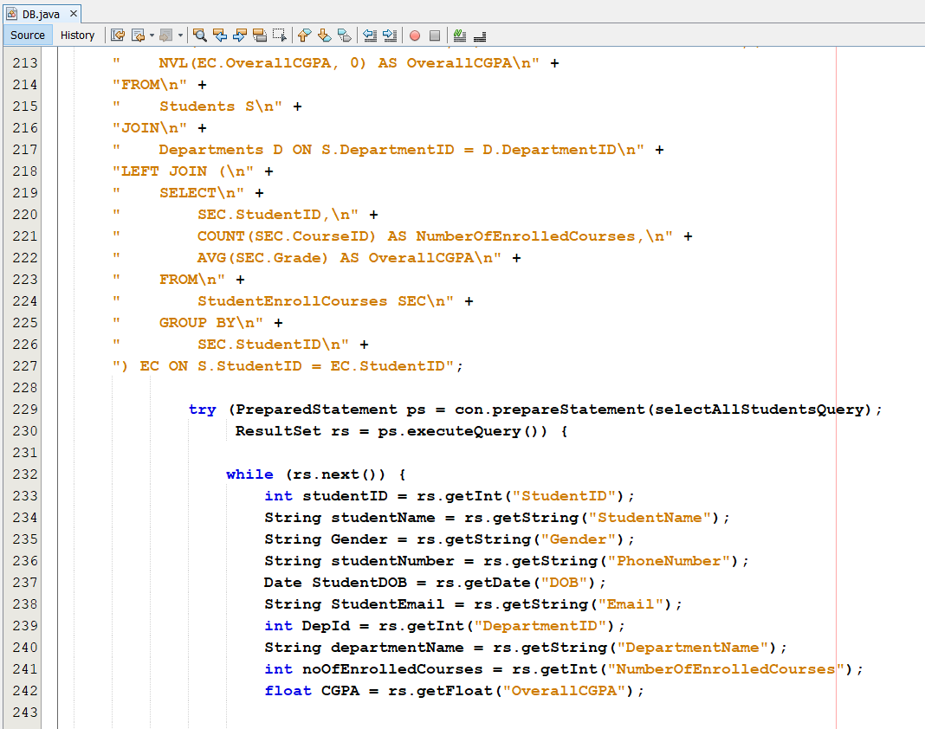
DAO Example

Slide 10
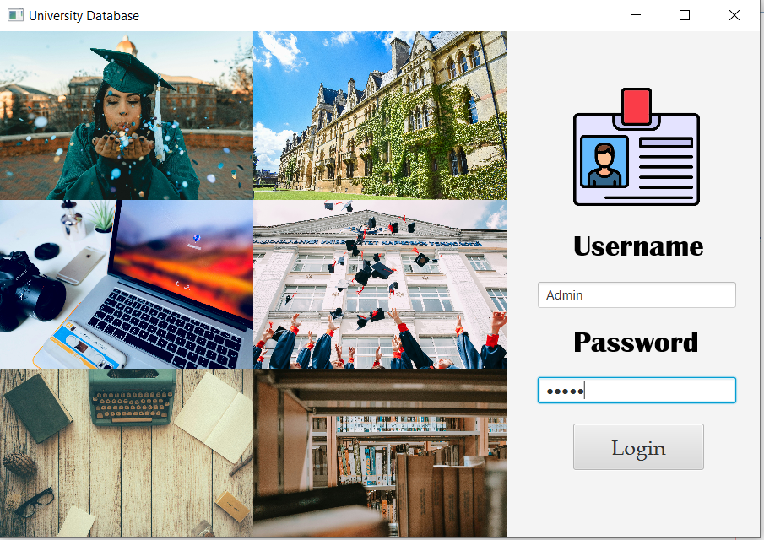
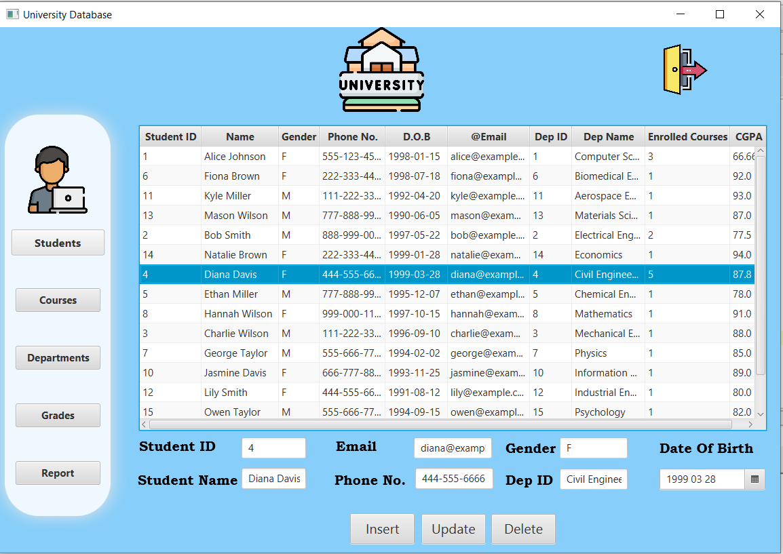
Java GUI Scenes
Login
Students

Slide 11
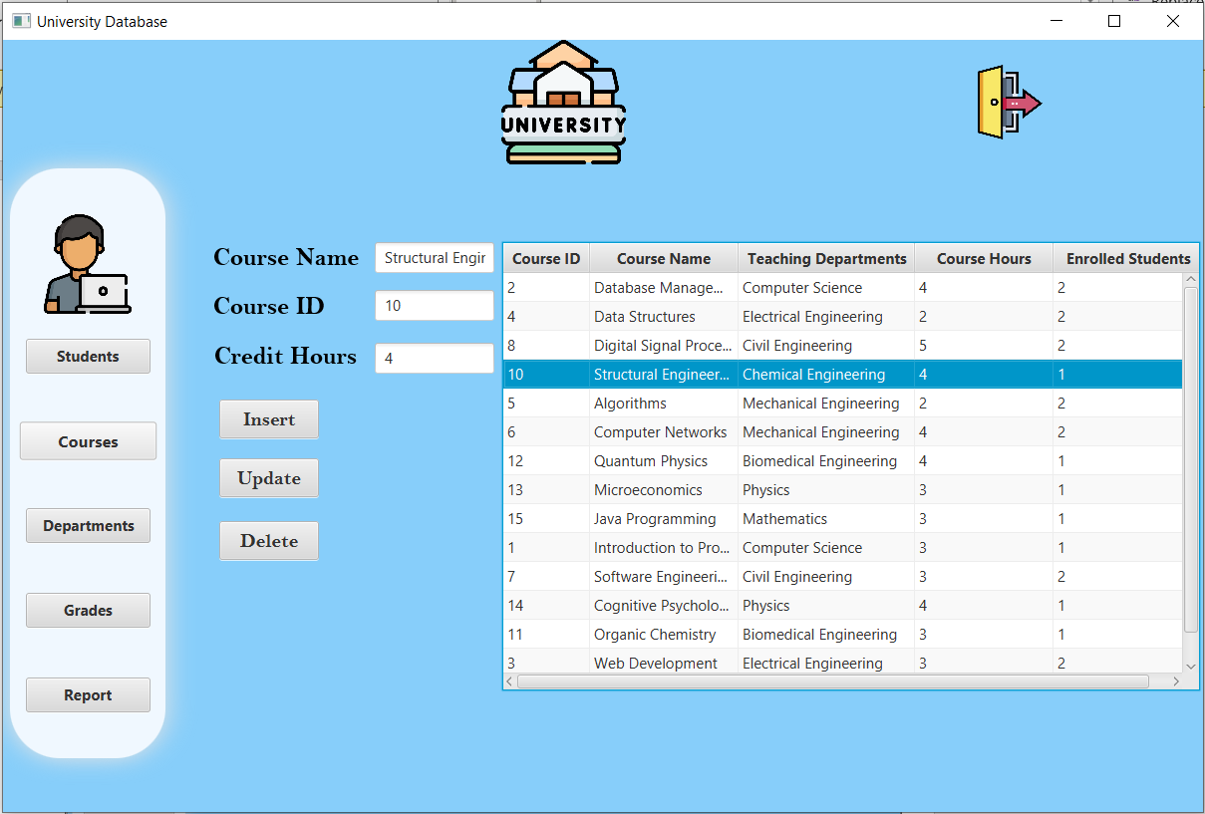
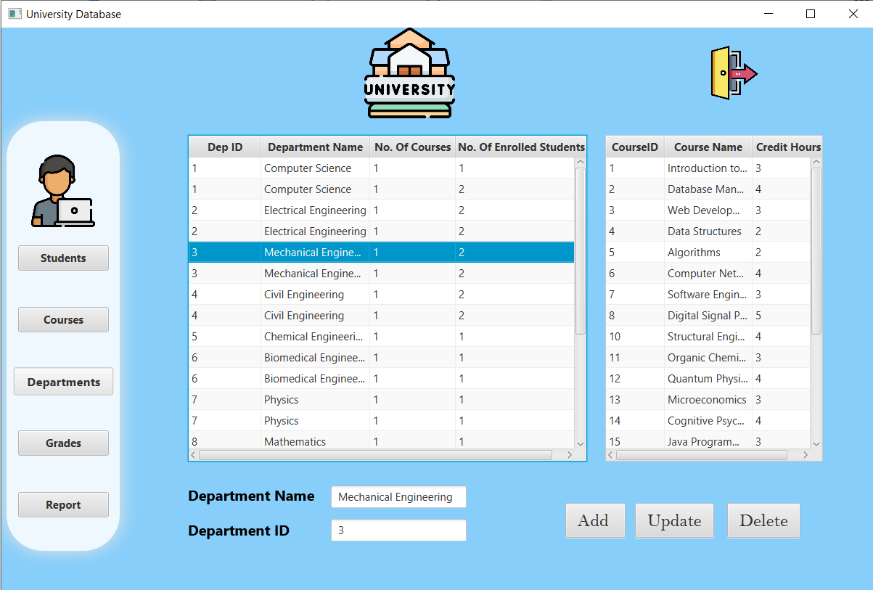
Java GUI Scenes
Courses
Departments

Slide 12
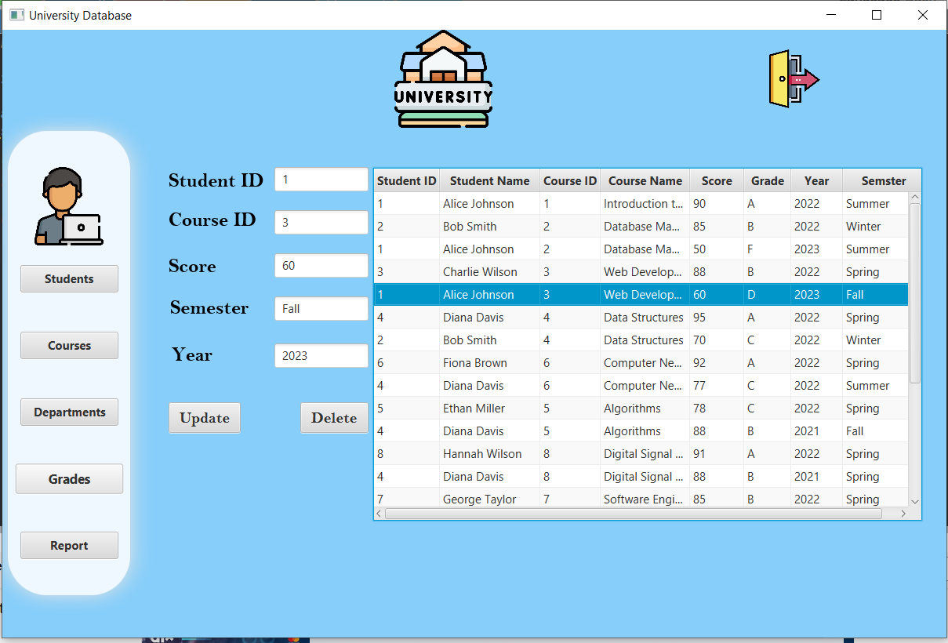
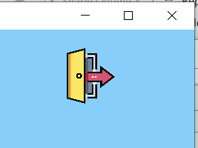
Java GUI Scenes
Logout
Grades

Slide 13
Thank You
For Any Information about the Project, you can contact me via my personal work email :
Muhamedkaram97@gmail.com
Or via my personal Phone Number : 01146069947
01016114252

